Slide 1

European Disability Card from proposal to reality
André Félix – Communications Coordinator
9 November 2023
Notes:
EDF logo
European Disability Card proposal and steps until it is adopted
André Félix – Communications Coordinator
9 November 2023

Slide 2
Practical information 1
Accessibility:
Real time captioning in English (activate in zoom or use external link from chat box) - automatic translation into German, Italian and Spanish on request
International Sign Language Interpretation
Please remain muted with camera off while you are not speaking
Notes:
Practical information 1
Accessibility:
Real time captioning in English (activate in zoom or use external link from chat box)
International sign Interpretation
Please remain muted with camera off while you are not speaking

Slide 3
Practical information 2
General rules:
During the questions and answers use raise hand function and take the floor or send questions via the Q&A function. The chat box is for technical questions only.
Introduce yourself when speaking
Please speak slowly
Notes:
Practical information 2
General rules:
During the questions and answers use raise hand function and take the floor or send questions via the chat box.
Introduce yourself when speaking
Please speak slowly

Slide 4
Why this Webinar?
The European Disability Card will be an important asset for travelling
The proposal does not mean the Card already exists: it’s the first step in a long journey.
Important for citizens with disabilities to know more and pressure political representatives for fast adoption.
Notes:
Why this Webinar?
The European Disability Card will be an important asset for travelling
The proposal does not mean the Card already exists: it’s the first step in a long journey.
Important for citizens with disabilities to know more and pressure political representatives for fast adoption.

Slide 5
Agenda
Keynote speech (video): MEP Duris Nicholsonová, lead negotiator for the European Parliament
Presenting the proposal and steps until it is adopted: André Félix, EDF Communications Coordinator
The position of the European Disability Forum: Alejandro Moledo, EDF Deputy Director
Questions and Answers
Notes:
Agenda
Keynote speech: MEP Duris Nicholsonová, lead negotiator
Presenting the proposal and steps until it is adopted: André Félix, EDF Communications Coordinator
The position of the European Disability Forum: Alejandro Moledo, EDF Deputy Director
Experience from Card user in Belgium: Pierre Gyselinck
Questions and Answers

Slide 6
Keynote video: MEP Duris Nicholsonová Lead negotiator for the European Parliament
Notes:
Keynote video: MEP Duris Nicholsonová Lead negotiator for the European Parliament

Slide 7
European Disability Card proposal and steps until it is adopted
André Félix – Communications Coordinator
9 November 2023
Notes:
EDF logo
European Disability Card proposal and steps until it is adopted
André Félix – Communications Coordinator
9 November 2023

Slide 8
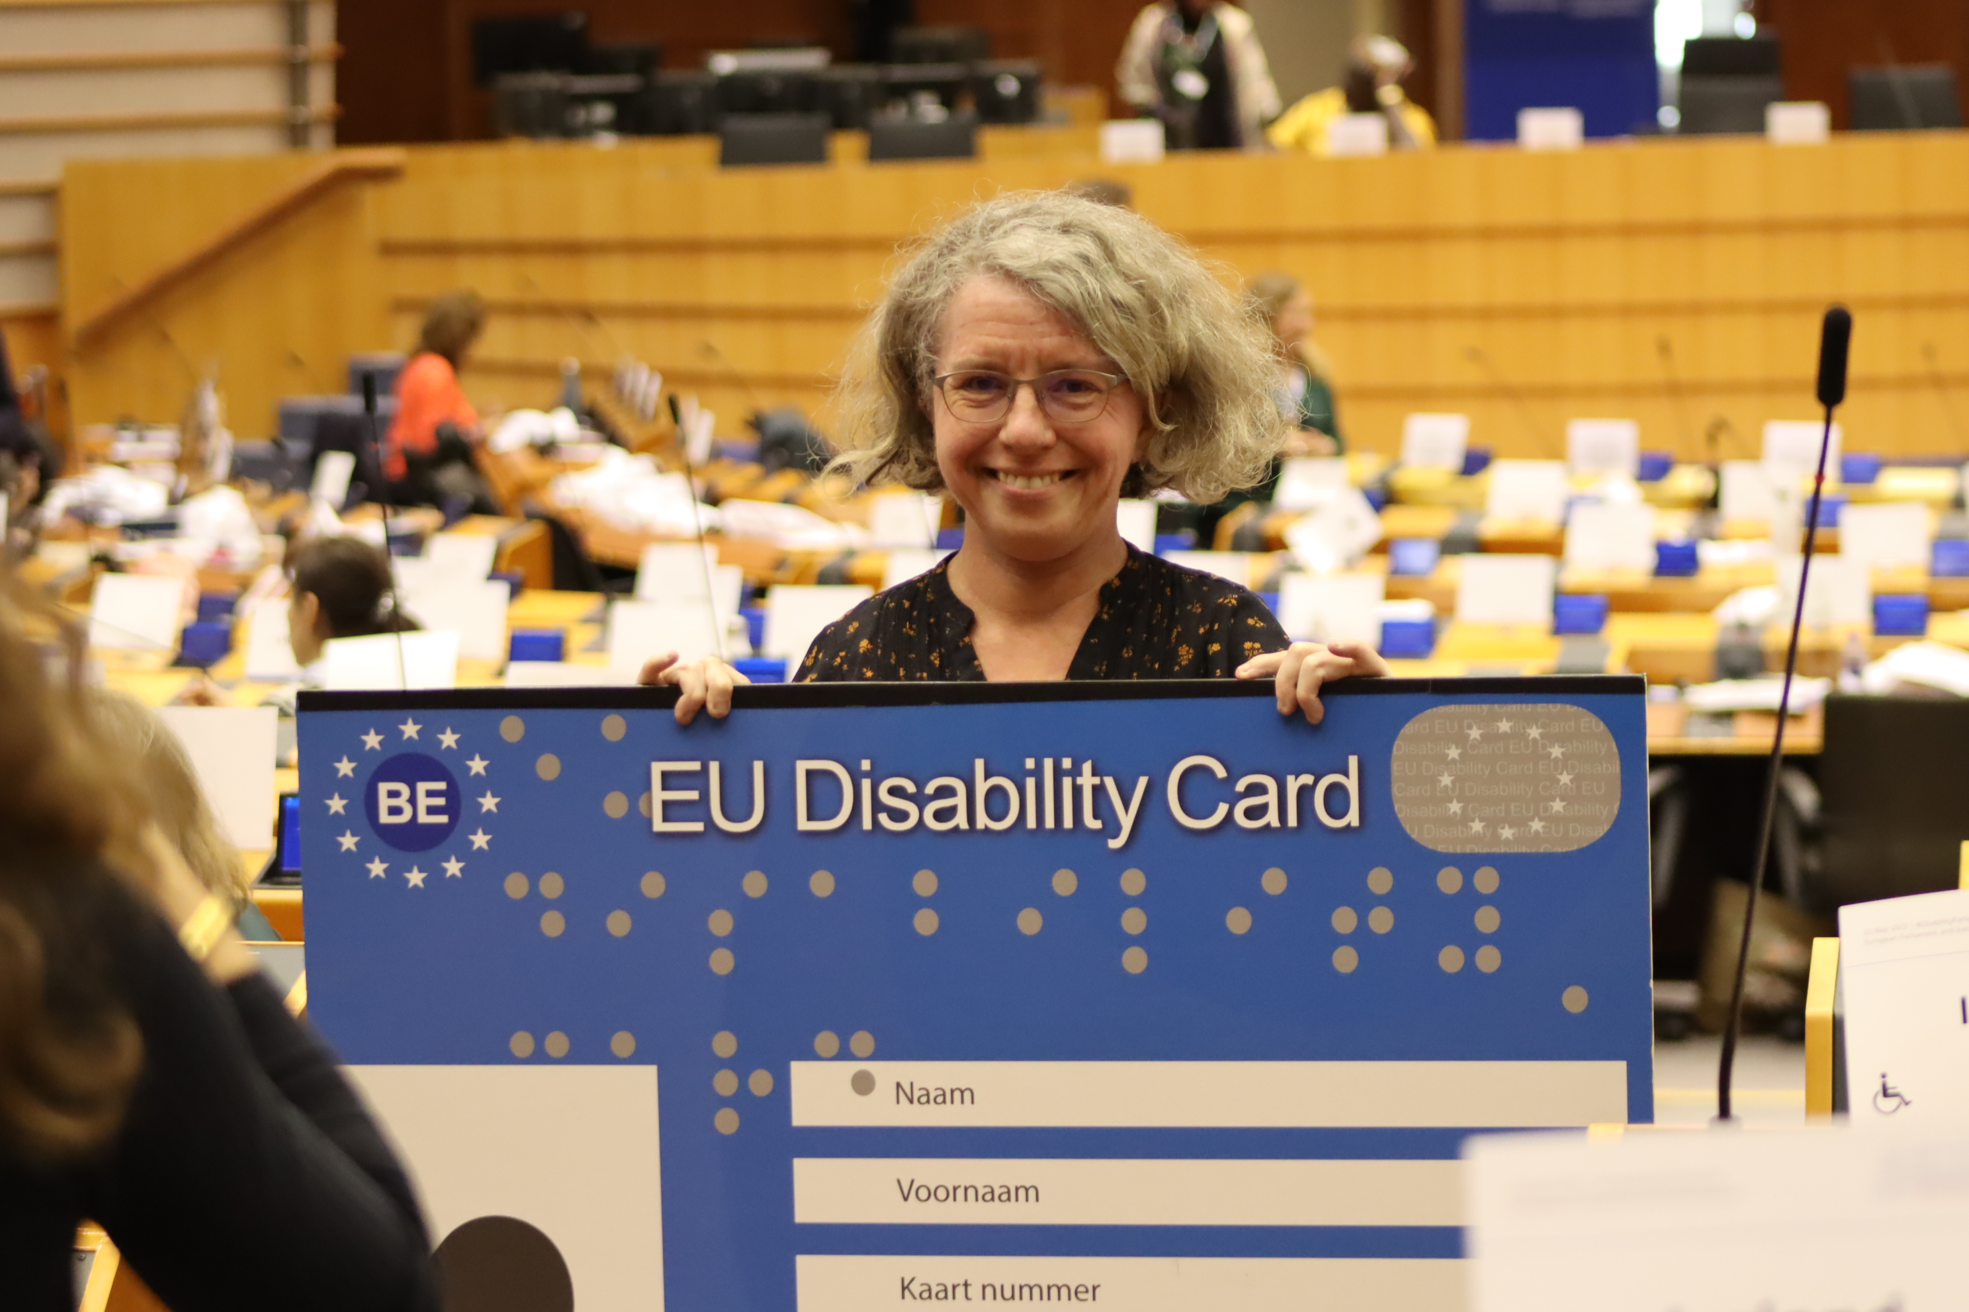
Agenda of the presentation
Origins
Pilot Project
Proposal at a glance
Next steps
Key Players and next steps
Notes:
Agenda
Origins
Pilot Project
Proposal at a glance
Next steps
Key Players
Image: A MEP holding a cardboard version of the Disability Card in the European Parliament

Slide 9
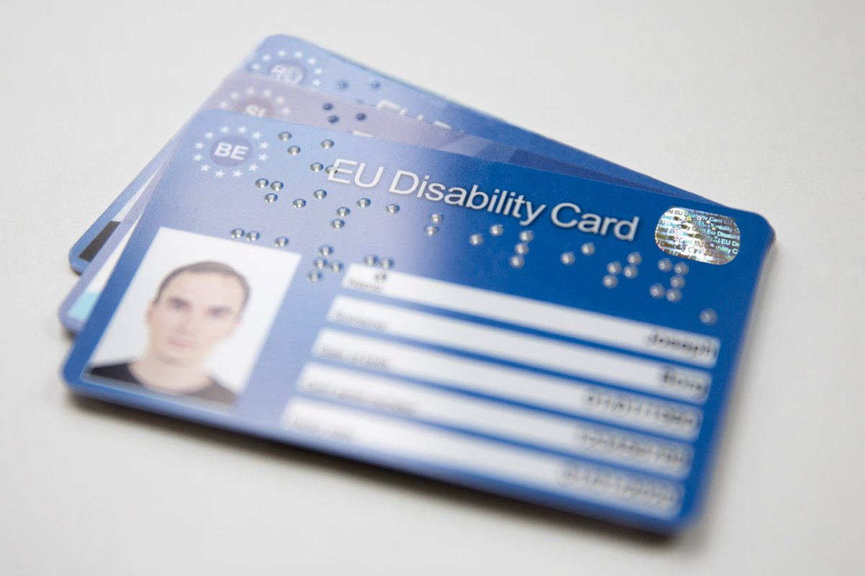
Origins
Demand from disability movement in 2011.
Ensure same disability-related rights and discounts.
Demands led to pilot projects.
Notes:
Origins
Demand from disability movement in 2011.
Ensure same disability-related rights and discounts.
Demands led to pilot projects in 8 countries.
Alt text: Close-up of the European Disability card

Slide 10
Pilot projects
Started in 2015.
Limited scope and funding: Culture, Leisure, Sport.
Voluntary for service providers
8 countries:
  Belgium, Cyprus, Estonia, Finland, Italy, Malta, Romania, and Slovenia
Notes:
Pilot projects
Started in 2015.
Limited scope and funding: Culture, Leisure, Sport.
Demands led to pilot projects in 8 countries:
Belgium, Cyprus, Estonia, Finland, Italy, Malta, Romania, and Slovenia

Slide 11
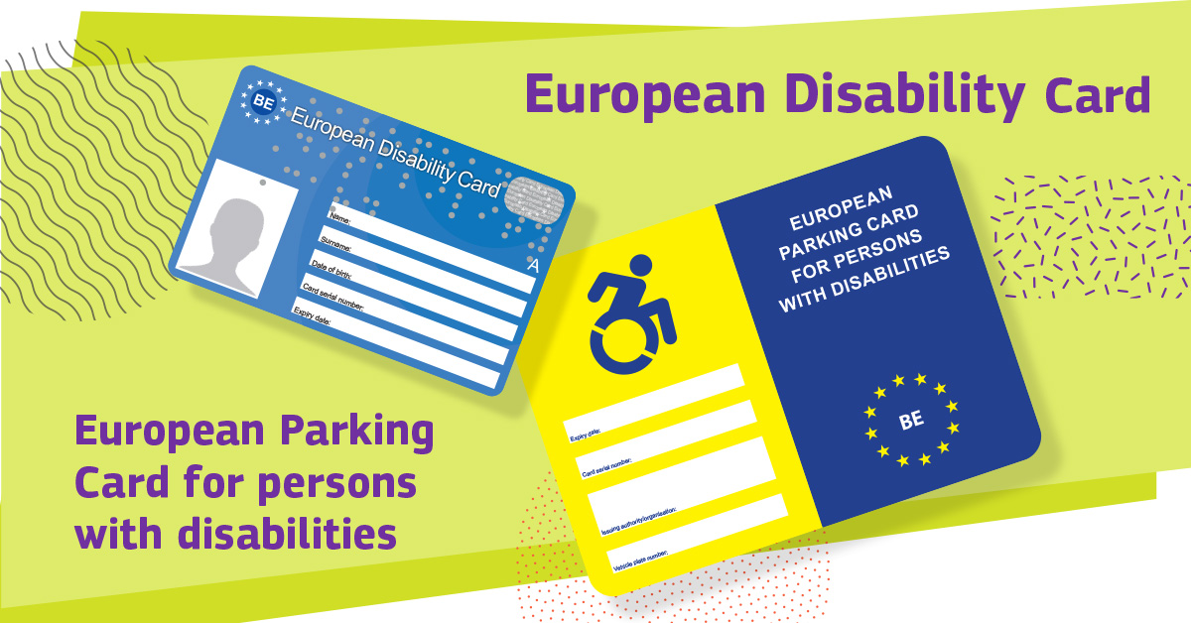
Proposal for European Disability Card and Parking Card
Notes:
The proposal for legislation presented two different Cards: the European Disability Card and the European Parking Card for Persons with Disabilities

Slide 12

At a glance
Announced in 2021.
Based on 2 public consultations, assessment of pilot projects.
Proposal on 6 September
“Start of the journey”
Notes:
At a glance
Announced in 2021.
Based on 2 public consultations, assessment of pilot projects.
Presented on 6 September
“Start of the journey”
Image: EDF President Yannis Vardakastanis with EU Commission for Equality, Belgian Minister for Disability and MEP Langensiepen holding a cardboard sign

Slide 13
European Disability Card
Physical and Digital Card.
Only for short stays.
Expands the scope of pilot projects: all EU countries; mutual recognition of disability status, except in social protection; covers all services including transport.
Available to EU citizens and non-EU citizens that are residents (additional legislation).
Notes:
European Disability Card
Physical and Digital Card.
Only for short stays.
Expands the scope of pilot projects: all EU countries; mutual recognition of disability status, except in social protection.
Available to EU citizens and non-EU citizens that are residents (additional legislation).

Slide 14
European Disability Card continued
Takes the form of a Directive: means the EU countries are responsible to adapt and enforce the Card.
Currently, EU Countries will have 18 months from the date the law enters into force to adapt the law and start delivering the Card.
This means, at least 2 to 3 years until it’s a reality.
Notes:
European Disability CardStarted in 2015.
Takes the form of a Directive: means the EU countries are responsible to adapt and enforce the Card.
Currently, EU Countries will have 18 months from the date the law enters into force to adapt the law and start delivering the Card.
This means, at least 2 to 3 years until it’s a reality.

Slide 15
European Parking Card
Same card across the Union.
Recognised everywhere
Replaces national Cards.
Parking spaces and rules around it remain different.
Notes:
European Parking Card
Same card across the Union.
Recognised everywhere
Replaces national Cards.
Parking spaces and rules around it remain different

Slide 16
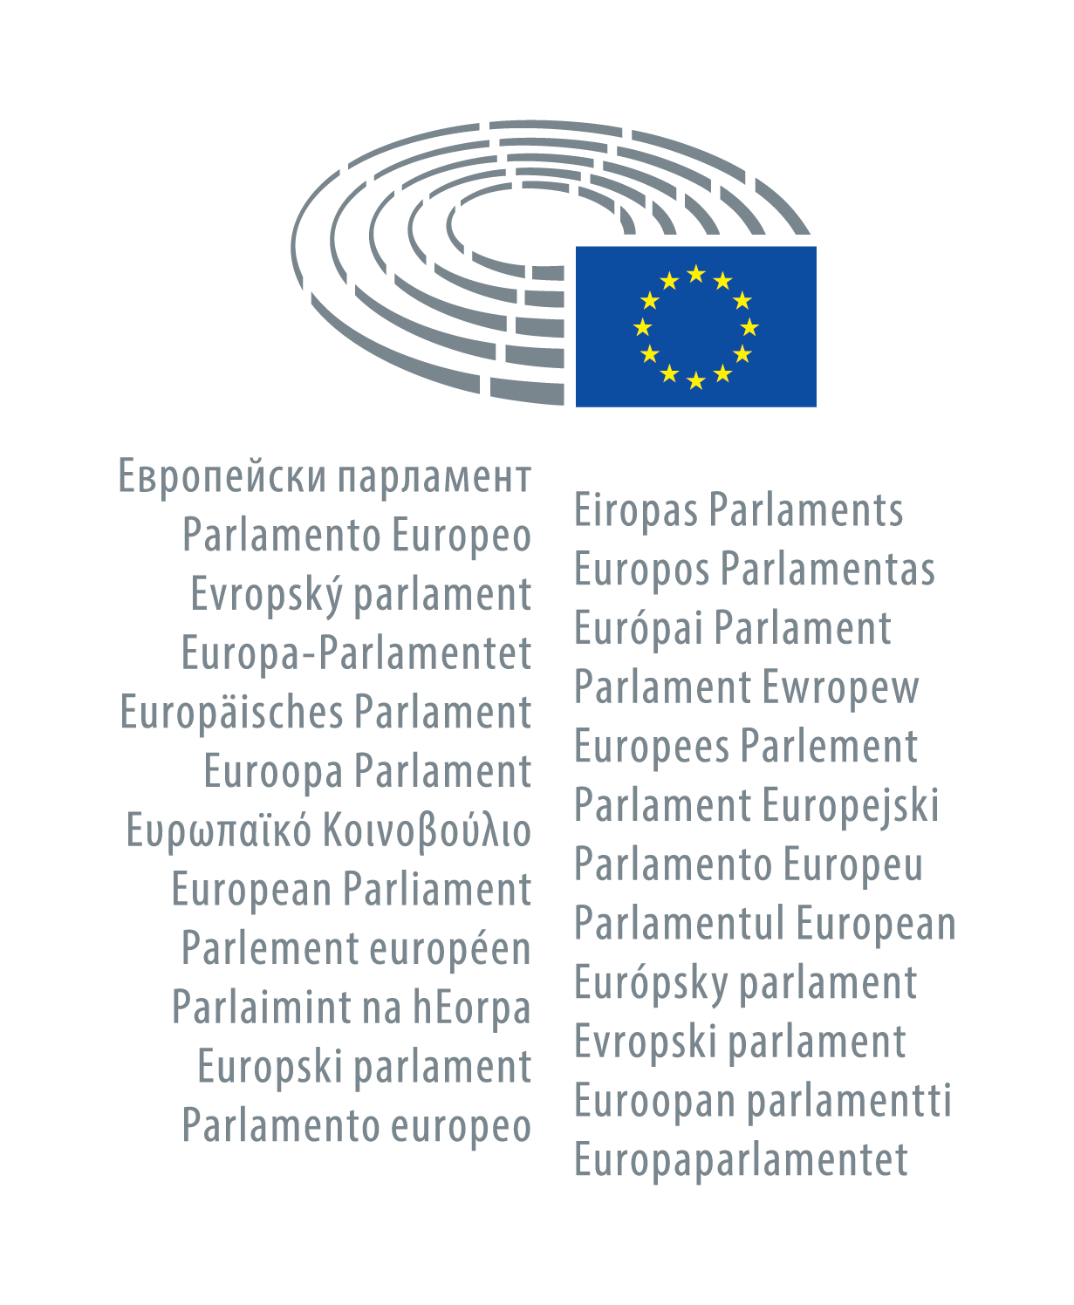

Key players
Notes:
Pilot projects
Started in 2015.
Limited scope and funding: Culture, Leisure, Sport.
Demands led to pilot projects in 8 countries:
Belgium, Cyprus, Estonia, Finland, Italy, Malta, Romania, and Slovenia

Slide 17
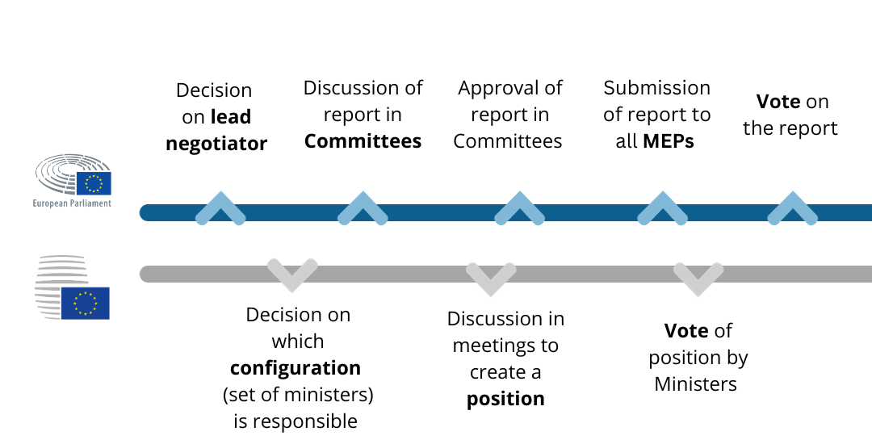
Next steps – phase 1
Notes:
Next steps
Graph showing two different timelines. The timeline above is for the European parliament with the following steps: decision on lead negotiator then discussion of report in Committees, then approval of report in Committees; submission of report to all MEPs and finally vote on the report.
The timeline below is for the European Council: Decision on which set of ministers is responsible; discussion in meetings to create a position and vote of position by ministers

Slide 18
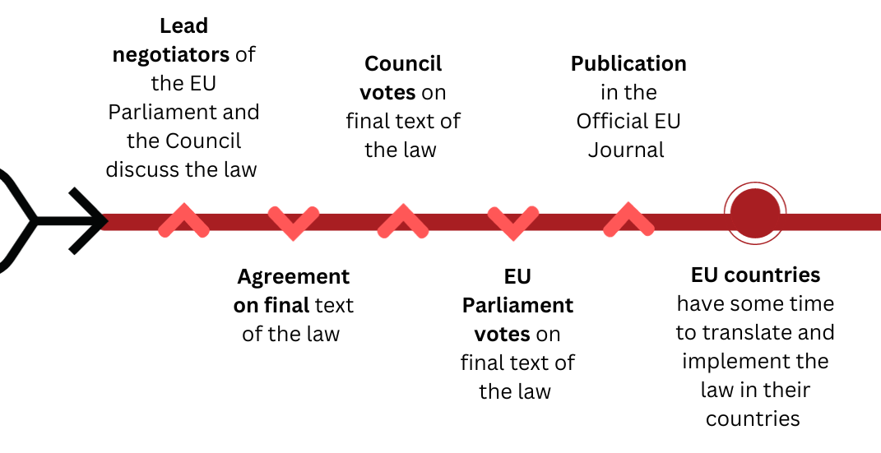
Next steps – phase 2
Notes:
Next steps – phase 2Started in 2015.
Graph showing a timeline with following points: lead negotiators of the EU Parliamn and Council discuss the law; agreement on the final text of the law; Council Votes on final text of the Law, EU Prliament votes on the final text of the law; then publication in the Official EU Journals, and then EU Countries have some tim to implement the law

Slide 19
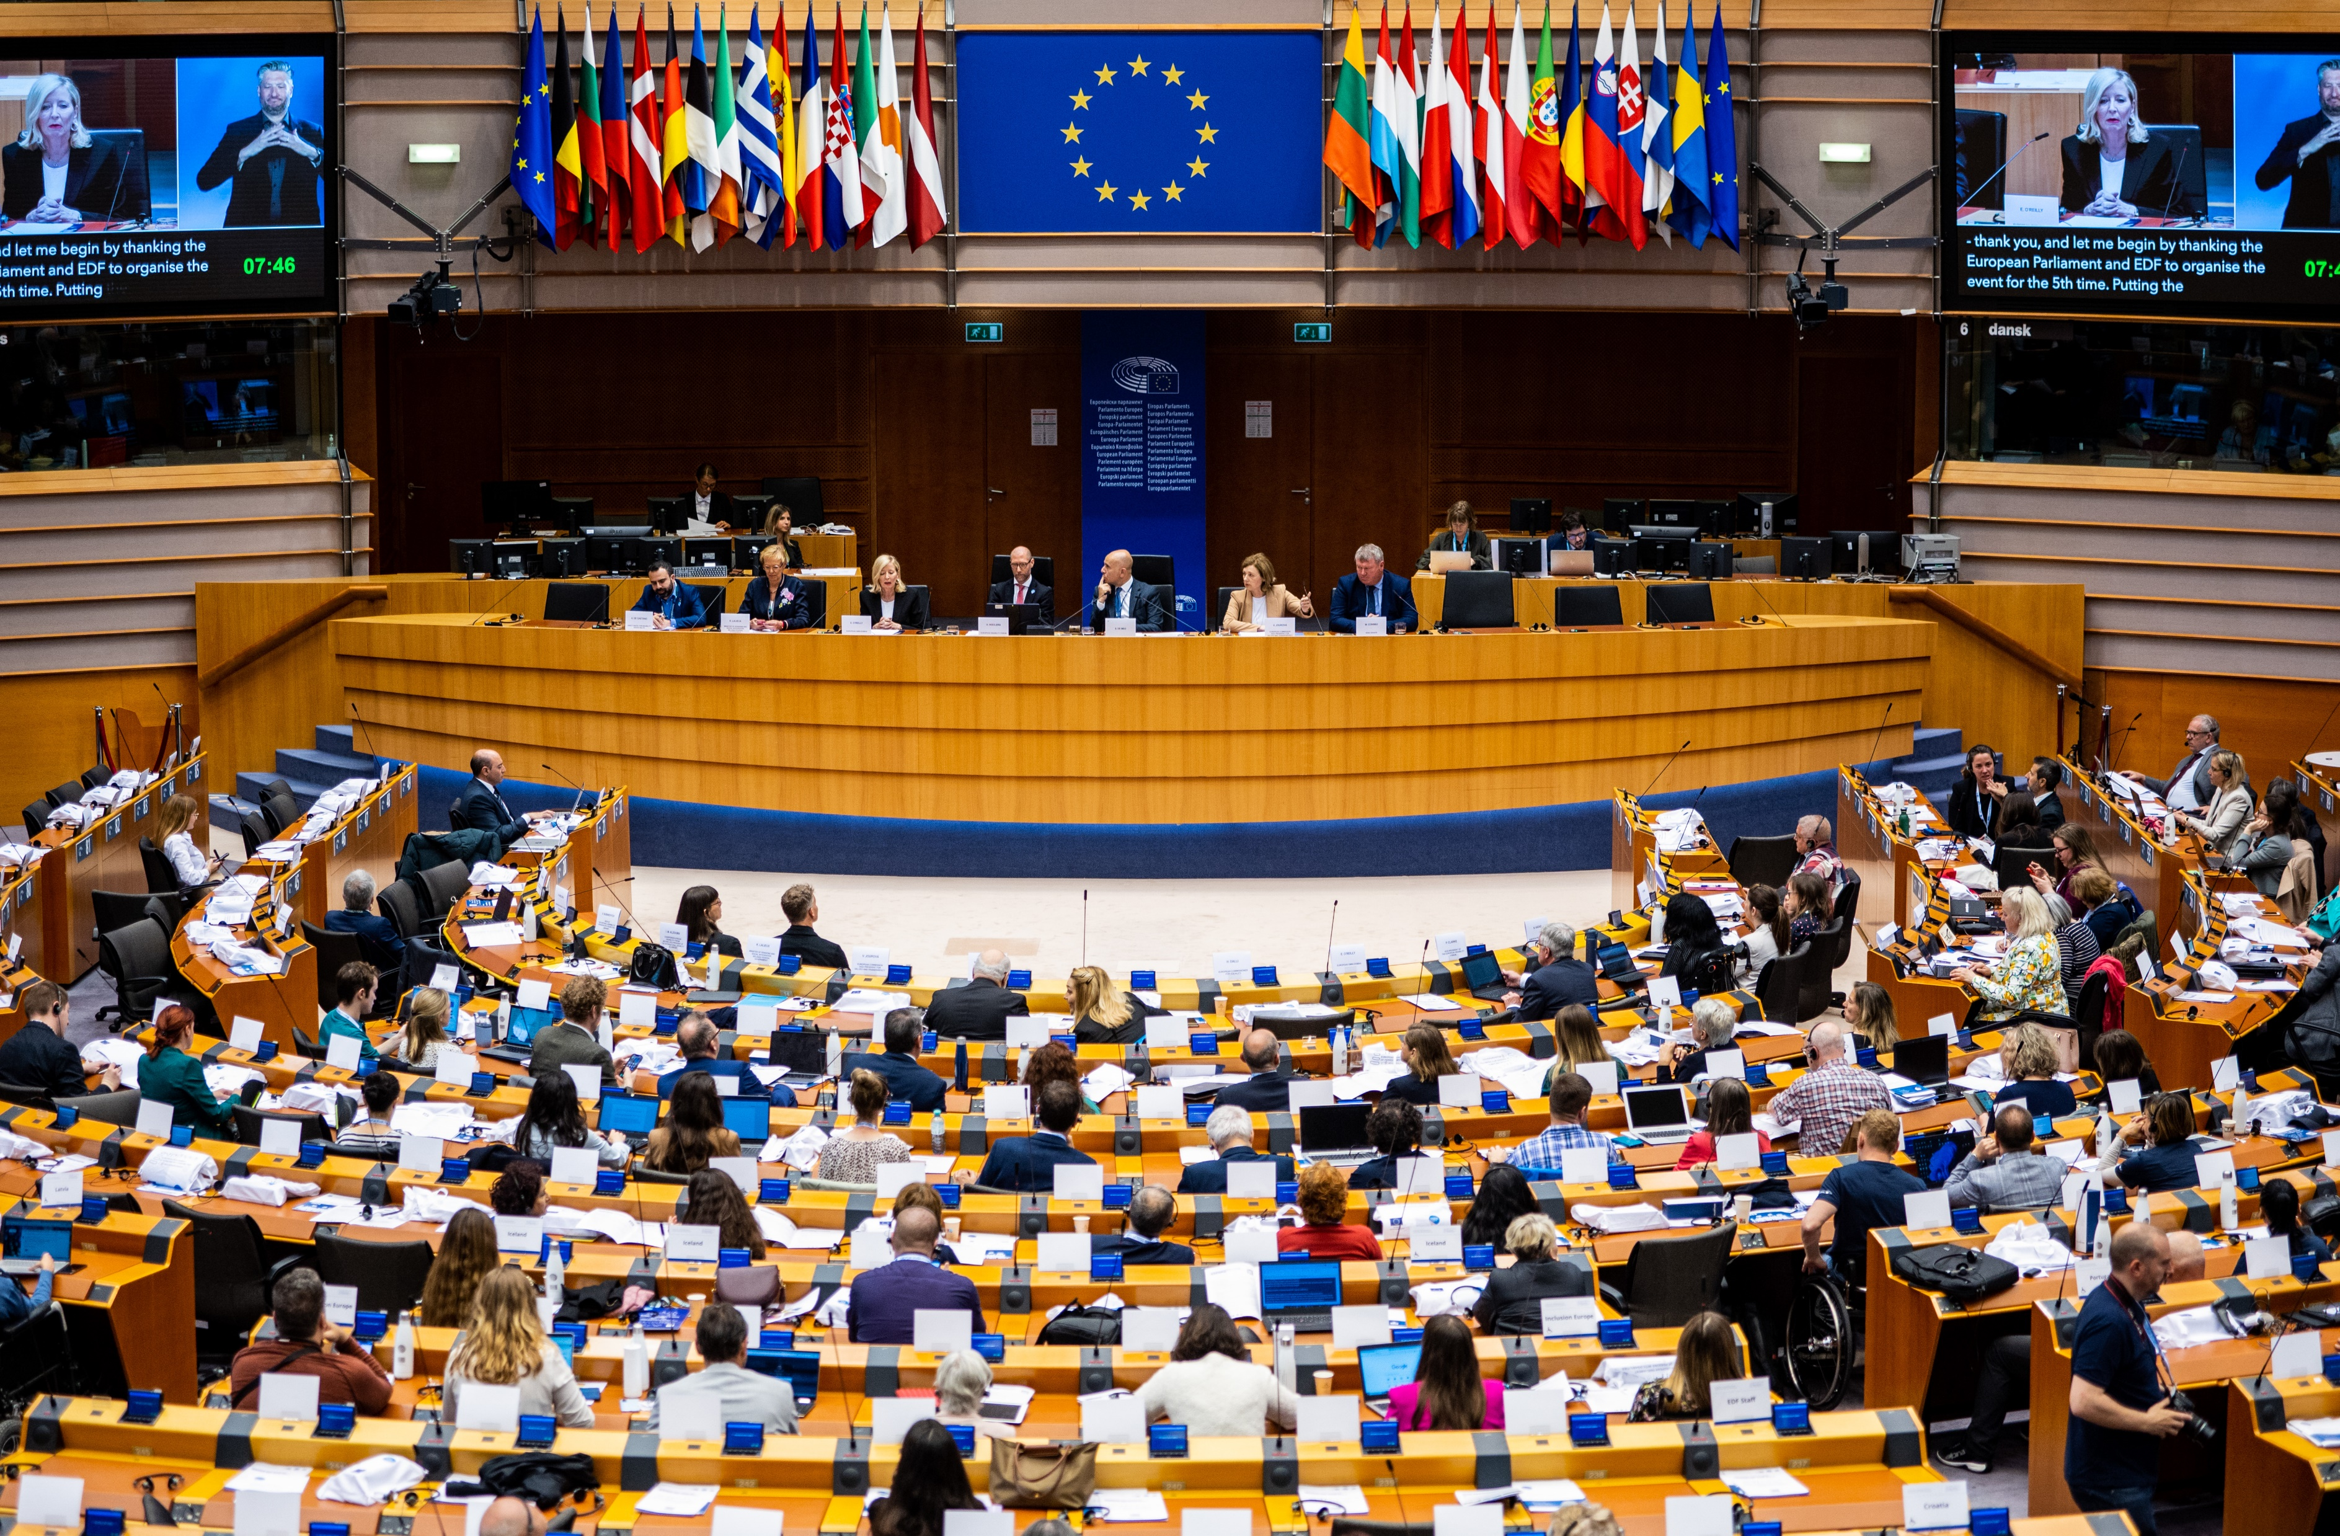
European Parliament
Main Committee: Committee on Employment and Social Affairs. Associated Committee: Transport
Supporting Committees: Internal Market, Women’s Rights, Petitions
Notes:
European Parliament
Main Committee: Committee on Employment and Social Affairs
Associated Committee: participates in trilogues
Supporting Committees: Internal Market, Transport, Women’s Rights, Petitions

Slide 20
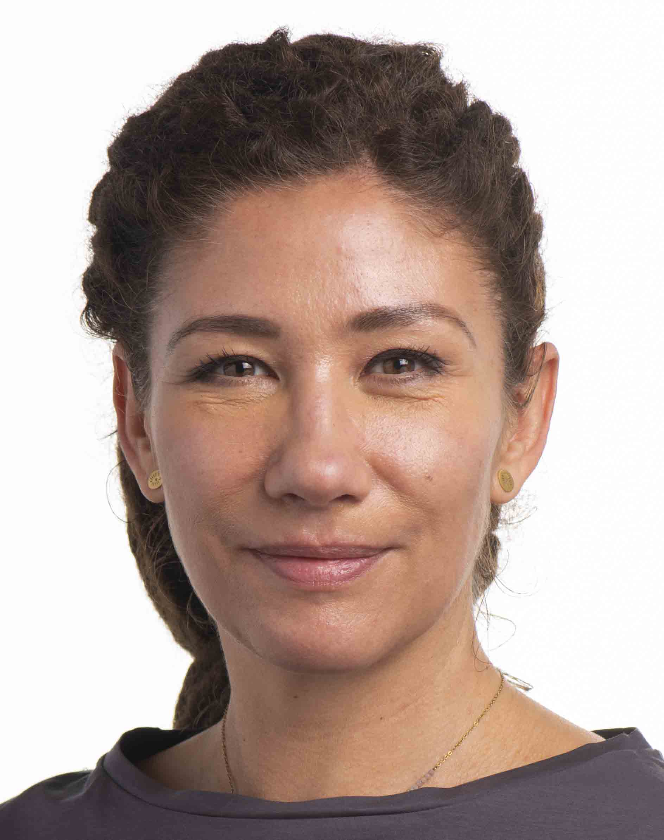

European Parliament – Main negotiator
Lucia Ďuriš Nicholsonová
Slovakia
Notes:
European Parliament – Main negotiator
Lucia Ďuriš Nicholsonová
Slovakia
Logo of the Renew Europe group in the European Parliament

Slide 21
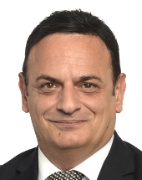
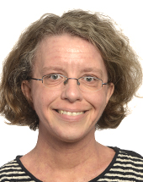
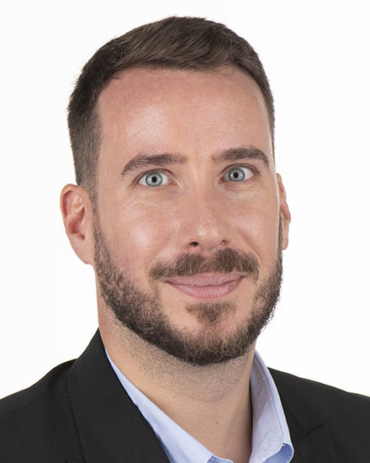
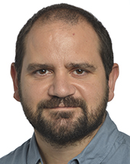
European Parliament – supporting negotiators
Katrin Langensiepen
Germany
Greens/EFA
David Casa
Malta
European People’s Party
João Albuquerque
Portugal
Socialists & Democrats
José Gusmão
Portugal
The Left - GUE
Notes:
European Parliament – supporting negotiators
David Casa
Malta
European People’s Party
João Albuquerque
Portugal
Socialists & Democrats
Katrin Langensiepen
Germany
Greens/EFA
José Gusmão
Portugal
The Left - GUE

Slide 22
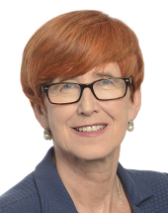
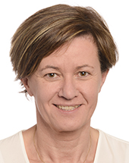
European Parliament – supporting negotiators continued
Elżbieta Rafalska
Poland
Conservatives & Reformists
Elena Lizzi
Italy
Identity and Democracy
Notes:
European Parliament – supporting negotiators
Elżbieta Rafalska
Poland
Conservatives & Reformists
Elena Lizzi
Italy
Identity and Democracy

Slide 23
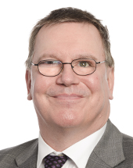
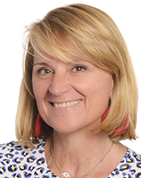
European Parliament – negotiators other Committees
Transport Committee:
Erik Bergvist
Sweden
Socialists & Democrats
Women’s Rights Committee:
Rosa Estaràs Ferragut
Spain
European People’s Party
Notes:
European Parliament – negotiators other Committees
Transport Committee:
Erik Bergvist
Sweden
Socialists & Democrats
Women’s Rights Committee:
Rosa Estaràs Ferragut
Spain
European People’s Party

Slide 24


European Council
Representatives of National Ministries.
Presidency leads negotiations:
  Until end 2023: Spain
  First semester 2024: Belgium
Notes:
European Council
Representatives of National Ministries.
Presidency leads negotiations:
Until end 2023: Spain
First semester 2024: Belgium

Slide 25
The position of the European Disability Forum
Alejandro Moledo – Deputy Director & Head of Policy
9 November 2023
Notes:
EDF logo
The position of the European Disability Forum
The position of the European Disability Forum
Alejandro Moledo – Deputy Director & Head of Policy
9 November 2023

Slide 26
Proposal: strenghts & weaknesses
Strengths:
Directive (binding law)
Mutual recognition
All services
Including personal assistants
Respects privacy
Can complement national cards
Digital capabilities
Voluntary use
Separate from the Parking Card
Weaknesses:
Totally excludes social protection
No link with EU mobility programmes
Raising awareness only by Member States
Minor involvement of persons with disabilities and their organisations
Potential fees to get the Card
Notes:
Proposal: strenghts & weakn
Strengths:
Directive (binding law)
Mutual recognition
All services
Including personal assistants
Respects privacy
Can complement national cards
Digital capabilities
Voluntary use
Separate from the Parking Card
Weaknesses:
Totally excludes social protection
No link with EU mobility programmes
Raising awareness only by Member States
Minor involvement of persons with disabilities and their organisations
Potential fees to get the Card
esses

Slide 27
EDF Proposals 1
Scope: should be retained to allow for the widest scope possible (all services including transport)
Scope: should be extended to include temporary protection when moving permanently to another Member State to work or study, while a persons’ disability status is being reassessed.
Issuing of Disability Card: free of charge.
Validity: not required to access other rights under EU law
Notes:
EDF Proposals 1
Scope: should be retained to allow for the widest scope possible (all services including transport)
Scope: should be extended to include temporary protection when moving permanently to another Member State to work or study, while a persons’ disability status is being reassessed.
Issuing of Disability Card: free of charge.
Validity: not required to access other rights under EU law

Slide 28
EDF Proposals 2
Parking Card: database with parking rules.
Parking Card format: in Braille.
Awareness raising: coordinated by EU, public website with information, more accessible (sign languages, easy to read format).
Complementing acts: involvement of persons with disabilities and their representative organisations.
Notes:
EDF Proposals 2
Parking Card: database with parking rules.
Parking Card format: in Braille.
Awareness raising: coordinated by EU, public website with information, more accessible (sign languages, easy to read format).
Complementing acts: involvement of persons with disabilities and their representative organisations.

Slide 29
EDF position papers
2022 position paper
Analysis of the proposal
Feedback to the Commission
Proposals for amendments
Check EDF dedicated webpage
Notes:
EDF position papers
2022 position paper
Analysis of the proposal
Feedback to the Commission
Proposals for amendments
Check EDF dedicated webpage

Slide 30
European Disability Forum
Staff member responsible:
Marie Denninghaus, Senior Policy Coordinator:
marie.denninghaus@edf-feph.org
Notes:
European Disability Forum
Staff member responsible:
Marie Denninghaus, Senior Policy Coordinator:
marie.denninghaus@edf-feph.org

Slide 31
Q&A Session

Slide 32
Thanks to
Our captioner & our International Sign Language interpreters .
Raquel for supporting.
MEP Nicholsonova for the video message
Alejandro for speaking.
Notes:
Thanks to
Our captioner & our International Sign Language interpreters .
Raquel for supporting.
MEP Nicholsonova for the video message
Alejandro for speaking.

Slide 33
Thank you for your attention
The European Disability Forum
www.edf-feph.org
Avenue des Arts 7-8, Bruxelles 1210, Belgium
Twitter: @MyEDF
Facebook: @MyEDF

