Slide 1

Omzetting van de “European Accessibility Act”
Toepassing van het europees toegankelijkheidswet in Belgie
Marie Denninghaus, EDF Policy Coordinator
9 Februari 2021
Notes:
EDF logo
Omzetting van de „European Accessibility Act“ – Toepassing van het europees toegankelijkheidswet in Belgie
Marie Denninghaus, EDF Policy Coordinator
9 February 2021
RICHTLIJN (EU) 2019/882 betreffende de toegankelijkheidsvoorschriften voor producten en diensten

Slide 2

Inhoud
Algemeen informatie over de EAA
Waar zijn wij nu?
Hoe kan het?
Voorbeeld: Zweden
Vragen & Antwoorden
Notes:
Presentation overview
Going beyond the Accessibility Act: what can you advance?
Ensuring effective application of the Act
Making contacts and building allies
Final thoughts

Slide 3

Wie zijn wij?
European Disability Forum (EDF)
100 million persons with disabilities in the EU
Brussels-based umbrella organisation
Advocating for the rights of persons with disabilities
Implementation of the UN CRPD in the EU and member countries
Nothing about us without us!
Notes:
Who we are
European Disability Forum (EDF)
100 million persons with disabilities in the EU
Brussels-based umbrella organisation
Advocating for the rights of persons with disabilities
Implementation of the UN CRPD in the EU and member countries
Nothing about us without us!
Image: group photo of EDF executive committee members

Slide 4
Algemeen informatie over de EAA

Slide 5

Wat is de EAA?
Directive (defines the objectives; Member States have to transpose into national law)
covers only certain products and services (mainly digital)
relies on manufacturers/service providers compliance and ex-post market surveillance checks.
Notes:
Richtlijn
Dienstverleners en producenten

Slide 6
...en wat niet?
A Regulation (directly applicable)
An anti-discrimination act (human rights)
Covering all products and services
Ex-ante controls
Notes:
Verordening
Anti-discriminatie

Slide 7

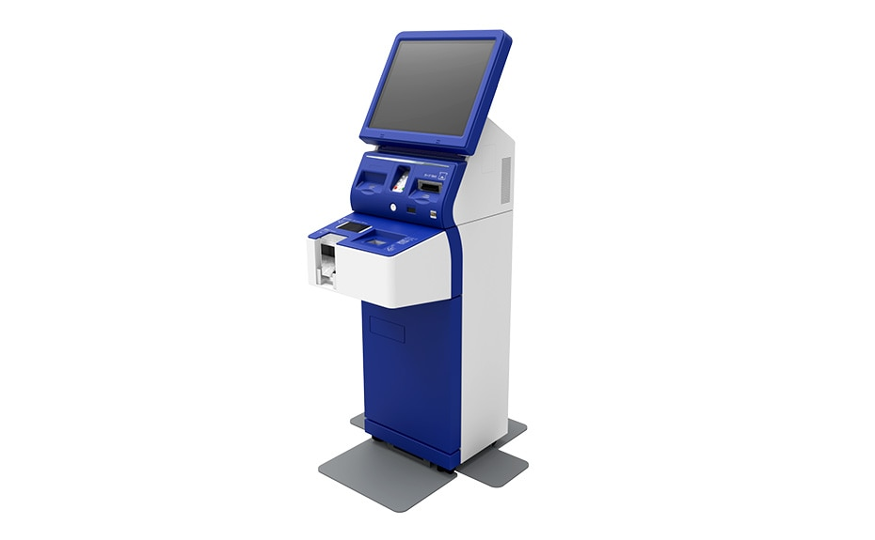


Wat zit er nu precies in?
Notes:
Producten en diensten:
Smartphones, tablets en computers
Ticketing machines and check-in machines
TV-toestellen en TV programma’s
Betaalautomaten en bankautomaten

Slide 8




Wat zit er nu precies in? (II)
Notes:
Products and services covered:
E-books and e-readers (e.g. kindle)
Online shopping (websites and applications of private companies)
112 – noodoproepnummmer
Telephony diensten

Slide 9

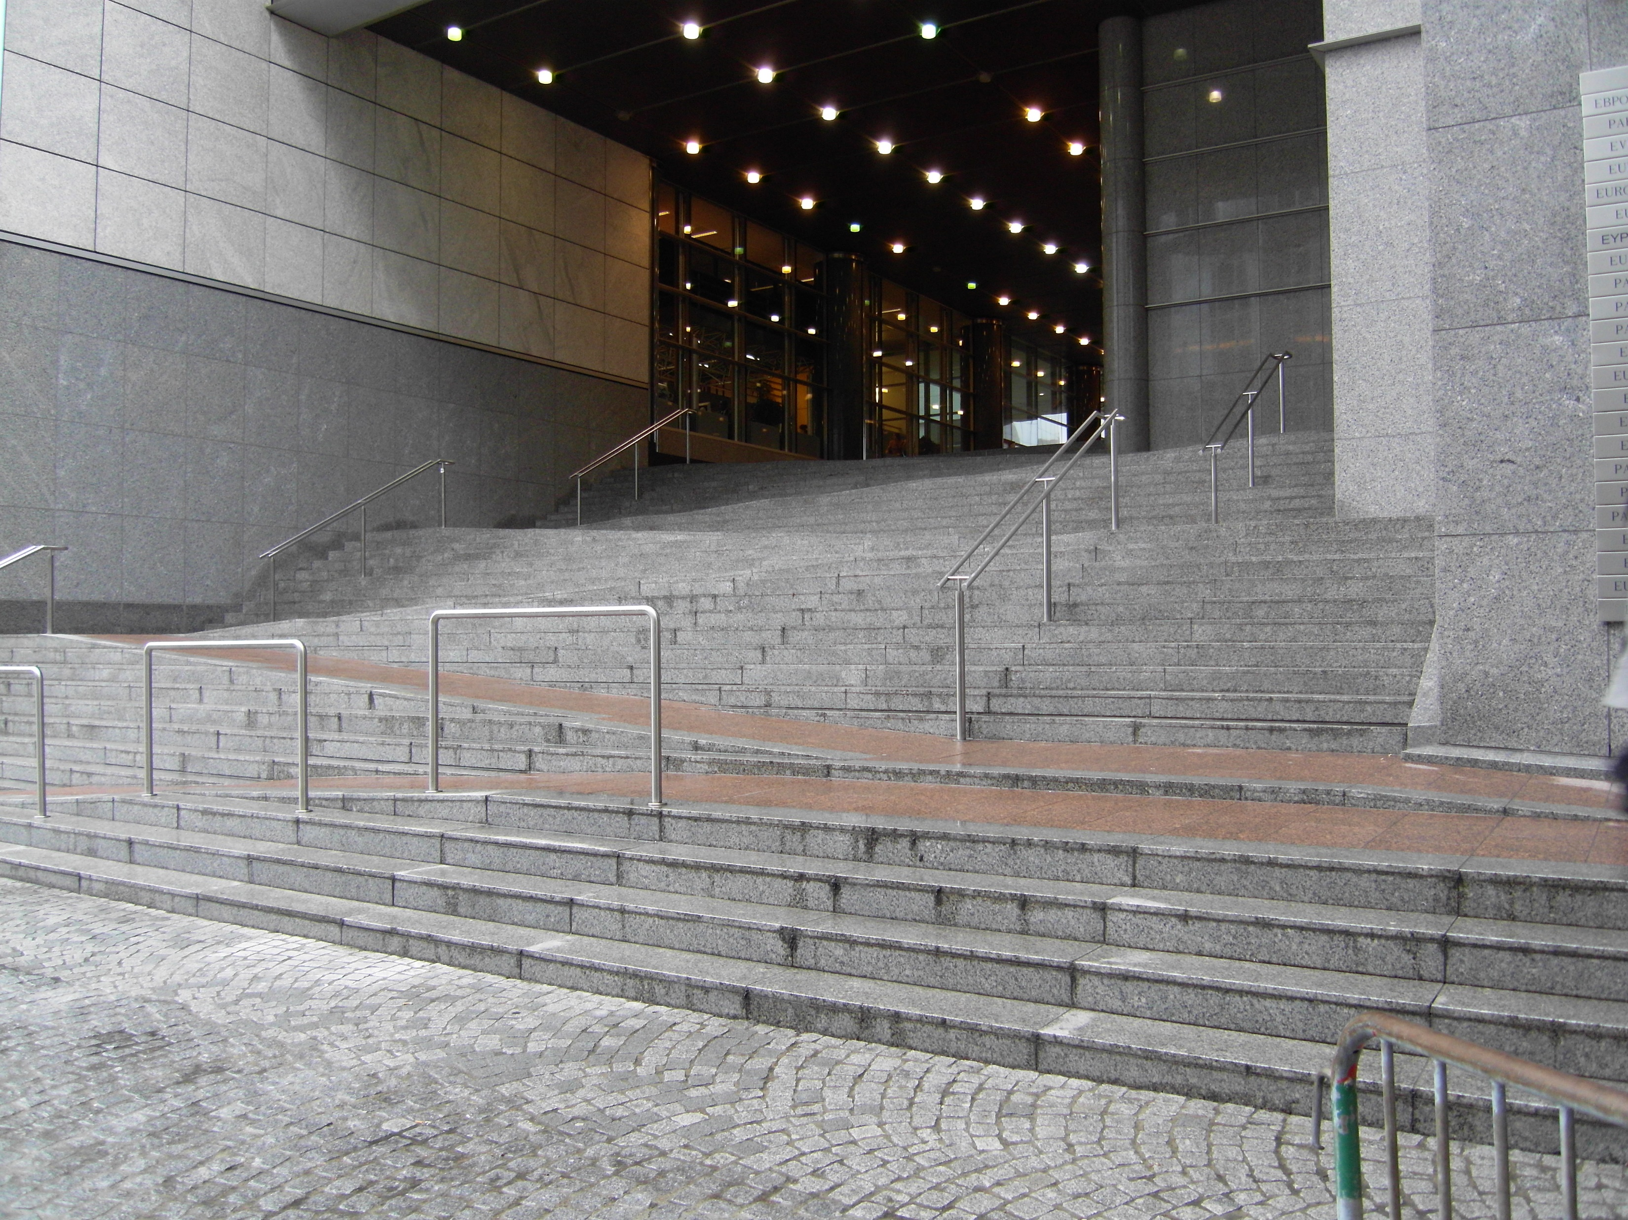


En wat niet?
Vervoer
Gebouwde omgeving
Huishoudtoestellen
Microbedrijven
Notes:
Begrensingen/Tekort
Transport
Built environment
Household appliances
Microenterprises

Slide 10
Verbeteringen met de EAA
Private companies and public authorities will be accountable
Will support the public procurement rules for accessible products and services
Will ensure EU funds respect accessibility for persons with disabilities
Organisation of persons with disabilities will be directly involved in the monitoring and implementation
Notes:
European Accessibility Act – further benefits
Je kunt voor het eereste ook bedrijven zo als ook overheiden aansprakelijk houden
Van toepassing voor openbare aanbestedingen (groot impact want veel geld wordt ervor uitgegeven)
Will ensure that national market surveillance authorities have the competence to hold private entities accountable
Non-compliant products can be withdrawn from the market
Will support the public procurement rules for accessible products and services
Will ensure EU funds respect accessibility for persons with disabilities

Slide 11
Waar zijn wij nu?
Notes:
EDF logo
Waar zijn wij nu?

Slide 12
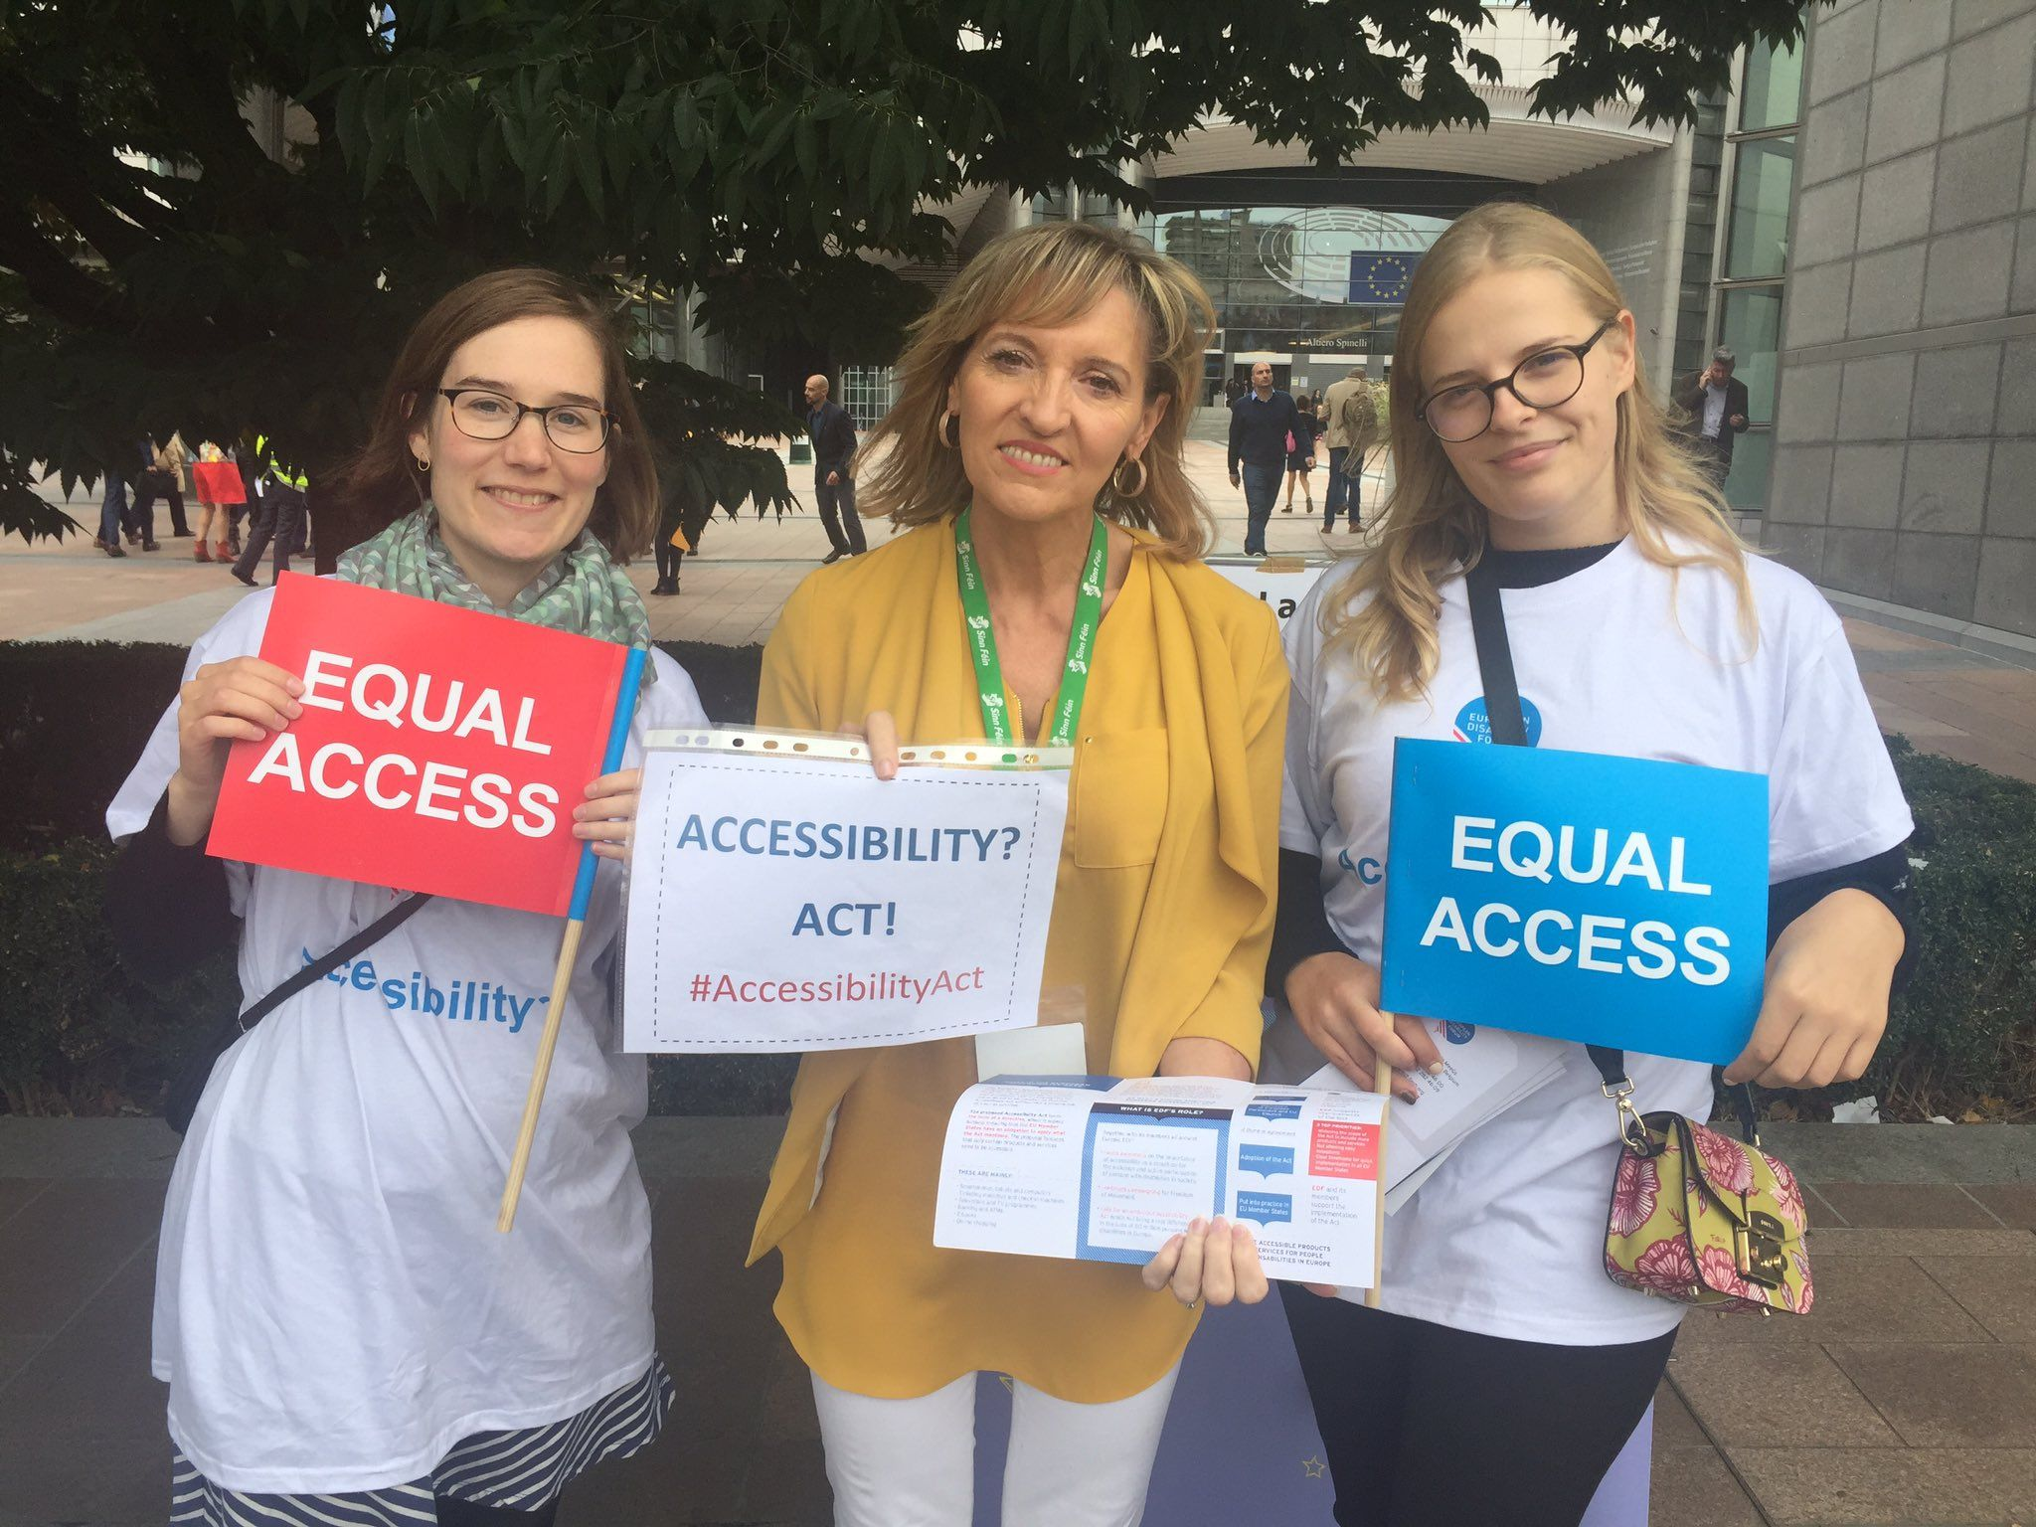
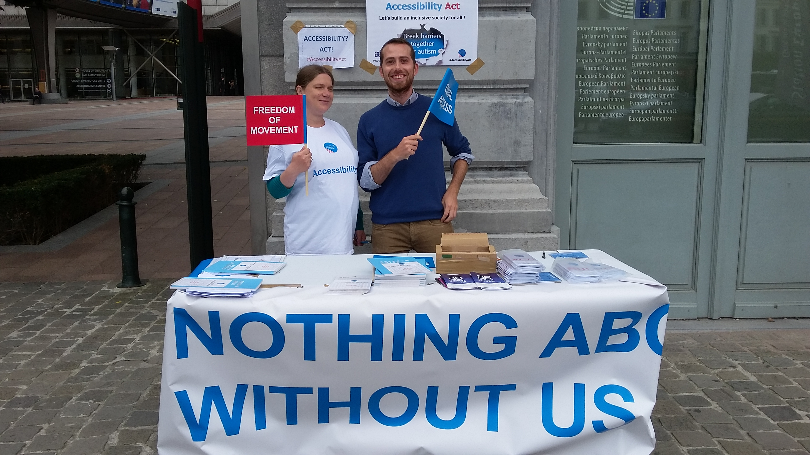
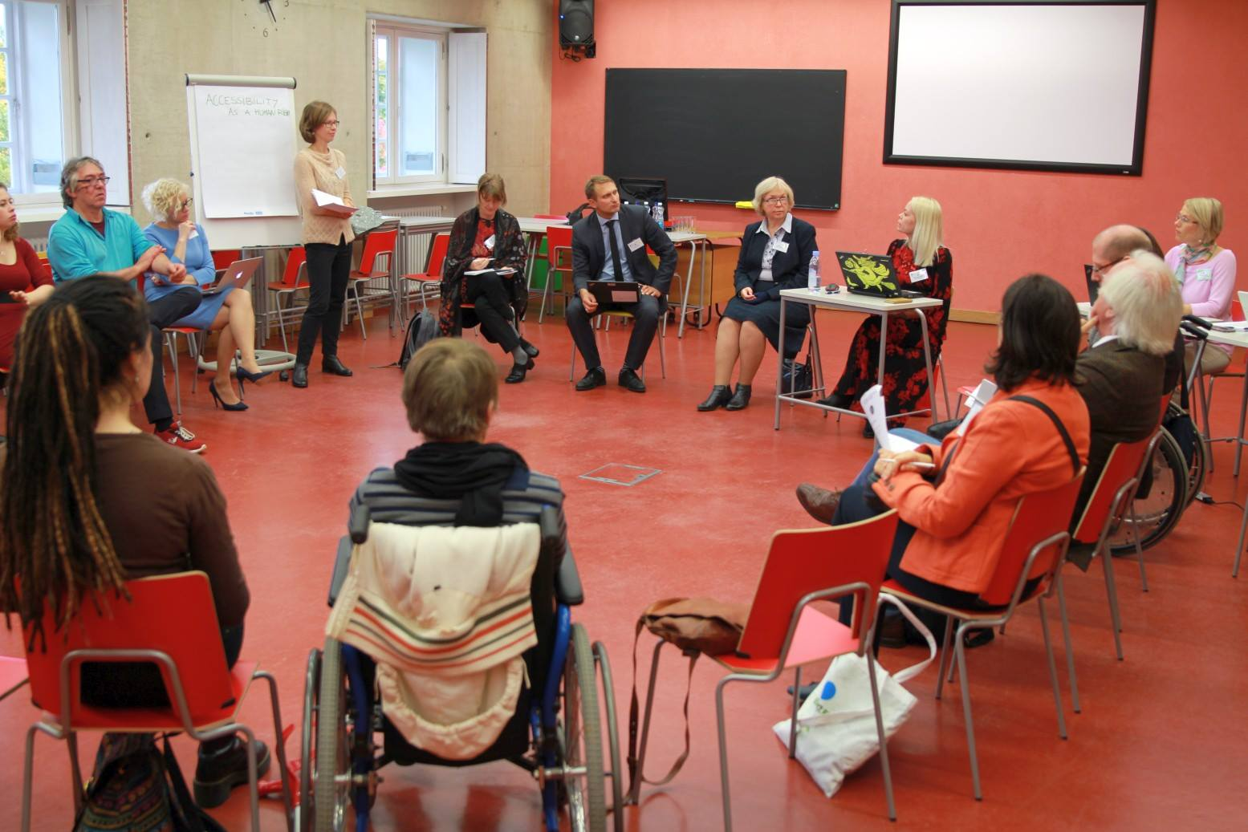

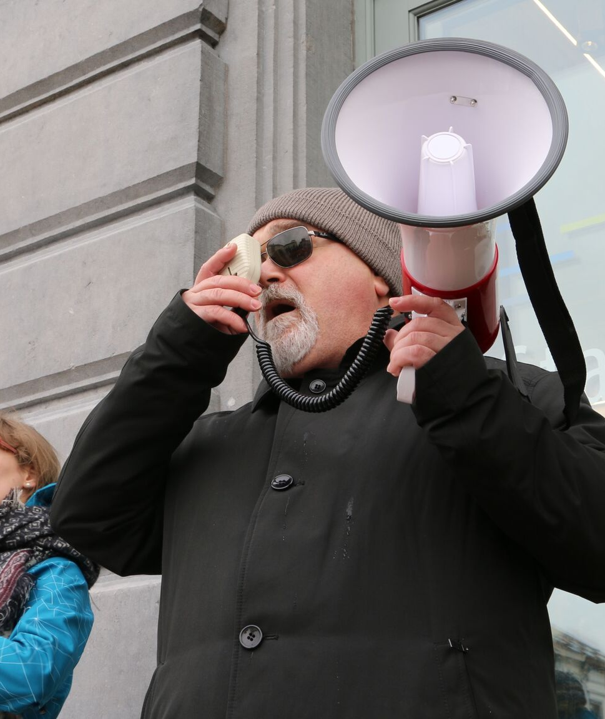
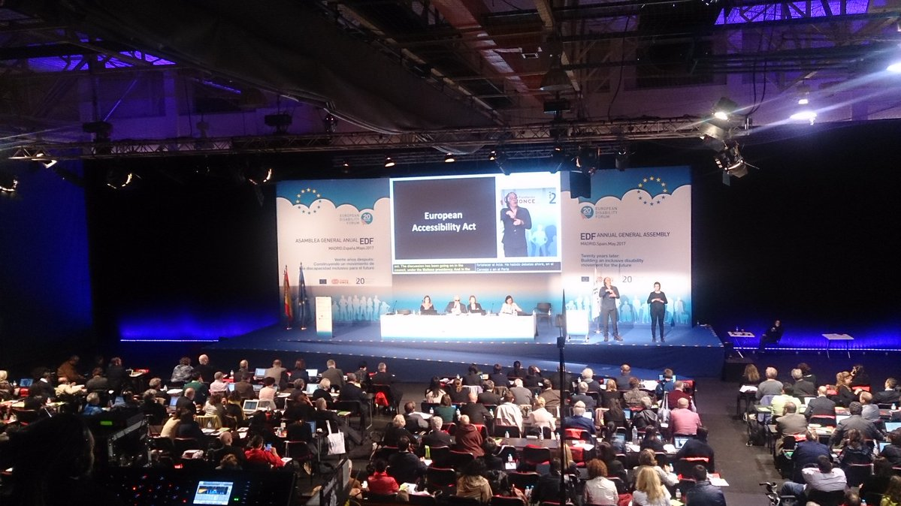
Het werk op europees niveau is (bijna) gedaan
Notes:
Europese (EDF) campagne sinds 2011, actieve wetgevingsprocedure 2015 – 2019
Beinvloeten van wetgeving was EDF prioriteit, veel werk aan besteedt

Slide 13


Nu is het aan jùllie!
Since 27 June 2019 in force
Member States have to change/create national laws
Transposition with in 3 years (already half of it has passed!!)
Some deadline for certain products longer
Notes:
Van kracht sinds 27 juni 2019
Omzetting in nationale wetgeving

Slide 14
Hoe kan het?
Notes:
EDF logo
Hoe kan het?

Slide 15
Verder gaan met de Accessibility Act: wat kunnen jullie doen? (1)
Verruim de reikwijdte:
All transport services and infrastructure incl. urban, suburban, regional transport, and passenger transport vehicles
All banking services – beyond retail banking
Household products – e.g. washing machines, dishwashers, refrigerators, etc.
National emergency numbers, other important numbers
Microenterprises providing services
Notes:
Going beyond the Accessibility Act: what can you advance?
Expand Scope:
All transport infrastructure and services incl. urban, suburban, regional transport, and passenger transport vehicles
All banking services – beyond retail banking
Household products – e.g. washing machines, dishwashers, refrigerators, etc.
National emergency, other important numbers
Microenterprises providing services

Slide 16
Verder gaan met de Accessibility Act: wat kunnen jullie doen? (2)
Pleit voor korte deadlines:
Important services: accessibility of answering to the single European emergency number ‘112’ by PSAPs (2027)
Deadline that are too long: e.g. existing self-service terminals (20 after entry into use)
Maak de wet sterker:
Obligations instead of voluntary requirements: built environment accessibility
Notes:
Going beyond the Accessibility Act: what can you advance?
Shorten deadlines:
Important services: accessibility of answering to the single European emergency number ‘112’ by PSAPs (28 June 2025)
Deadline that are too long: e.g. existing self-service terminals (+20 after entry into use)
Strengthen legal obligations:
Obligations instead of voluntary requirements: built environment accessibility

Slide 17
Correcte toepassing
Gebruik de Standards:
Accessibility of digital services and products - EN 301 549 (version V3.1.1)
Accessibility and usability of the built environment - prEN 17210 (coming soon!)
Expanding range of users with a design for all approach to accessibility - EN 17161:2019
Others: ePub3 for e-books
Standards die nog moeten komen:
Get involved in standardisation at national level when this starts
Notes:
Ensuring effective application of the Act
Use available Standards:
Accessibility of digital services and products - EN 301 549 (version V3.1.1)
Accessibility and usability of the built environment - prEN 17210 (coming soon!)
Expanding range of users with a design for all approach to accessibility - EN 17161:2019
Forthcoming EAA standards and technical specifications
Important to get involved in standardisation at national level when this starts

Slide 18
Werk met de overheid en partners! (1)
Government representatives:
Identify and contact relevant Ministries involved in transposition (can be more than one – transport, telecoms, finance, etc.)
Difficult to track? – start with ministry in charge of disability affairs, CRPD focal point
Members of National Parliament – especially members of committee tasked with the Act
Notes:
Making contacts and building allies (1)
Government representatives:
Identify and contact relevant Ministries involved in transposition (can be more than one – transport, telecoms, finance, etc.)
Difficult to track? – start with ministry in charge of disability affairs, CRPD focal point
Members of National Parliament – especially members of committee tasked with the Act

Slide 19
Werk met de overheid en partners!(2)
Potential allies:
Your Members of European Parliament
Consumer representatives: Members of BEUC
Other civil society organisations: DPOs, older persons’ organisations (member of AGE Platform)
Equality and human rights networks: Equality bodies and national human rights institutions (NHRIs)
Consumer representatives in standardisation: Members of ANEC (important when standardisation starts)
Notes:
Making contacts and building allies (2)
Potential allies:
Your Members of European Parliament
Consumer representatives: Members of BEUC
Other civil society organisations: DPOs, older persons’ organisations (member of Age Platform)
Equality and human rights networks: Equality bodies and national human rights institutions (NHRIs)
Consumer representatives in standardisation: Members of ANCEC (when standardisation starts)

Slide 20
Conclusie
Start NOW
Raise awareness: benefits of the Act, its important for EU legislation on Audiovisual Media, Electronic Communications, passengers’ rights and transport accessibility, EU Funds, Public Procurements
Offer support: web developers, manufacturers of digital products, services, etc – what’s in it for them?
Notes:
Final thoughts
Begin er nu aan!
Bewustzijn kwegen
Hulp aanbieden

Slide 21
Nuttige links:
Full text of the Accessibility Act
EDF Toolkit for transposition: European Accessibility Act
EDF introductory webinar on European Accessibility Act - June 2019
EDF resources and fist analysis of EAA after publication
Notes:
Nuttige links: EDF Resources
Directive (EU) 2019/882 of the European Parliament and of the Council of 17 April 2019 on the accessibility requirements for products and services (Text with EEA relevance) - RICHTLIJN (EU) 2019/882 betreffende de toegankelijkheidsvoorschriften voor producten en diensten
EDF Toolkit for transposition: European Accessibility Act
EDF introductory webinar on European Accessibility Act - June 2019
EDF resources and fist analysis of EAA after publication

Slide 22
Vragen/Question? ☺
Notes:
EDF Logo
Question? ☺

Slide 23
Bedankt/Merci!
European Disability Forum
Marie.denninghaus@edf-feph.org
www.edf-feph.org
Avenue des Arts 7-8, Bruxelles 1210, Belgium
Twitter: @MyEDF
Facebook: @MyEDF
Notes:
Thank you for your attention
The European Disability Forum
www.edf-feph.org
Avenue des Arts 7-8, Bruxelles 1210
Belgium
Twitter: @MyEdf
Facebook: @?

