Slide 1

Digitalisation and rights of persons with disabilities
Albert Prevos
Member of EDF executive committee
BDF online conference on digitalization – 17 March
Notes:
EDF logo
Digitalisation and rights of persons with disabilities
Albert Prevos
Member of EDF executive committee
BDF online conference on digitalization – 17 March

Slide 2
Outline of Presentation
Introduction of the European Disability Forum (EDF)
Legal Basis for right of equal access to digital technologies by persons with disabilities (CRPD)
Overview of EDF’s work on EU digital policies
EDF’s position on digitalisation and new technologies
Notes:
Outline of Presentation
Introduction of the European Disability Forum (EDF)
Legal Basis for right of equal access to digital technologies by persons with disabilities (CRPD)
Overview of EDF’s work on EU digital policies
EDF’s position on digitalisation and new technologies

Slide 3
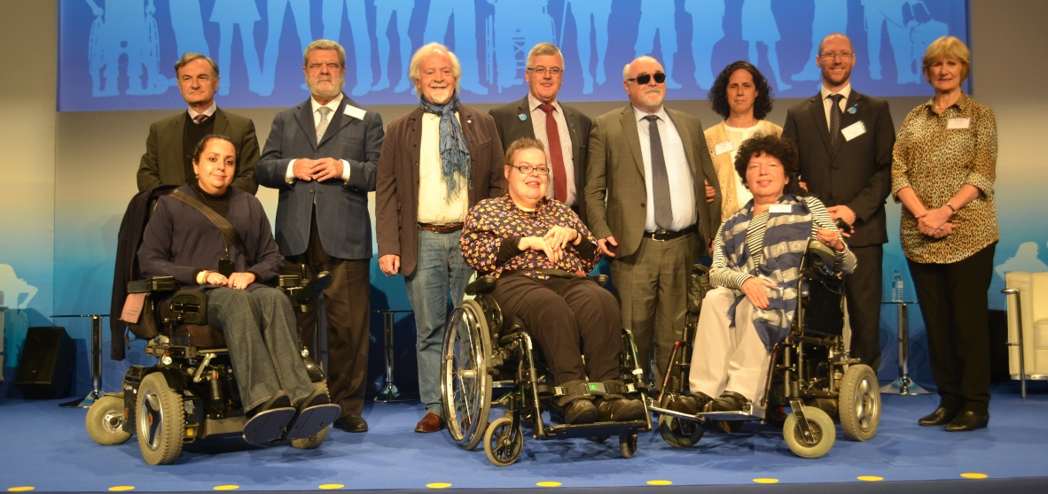
Who we are
European Disability Forum (EDF)
100 million persons with disabilities in the EU
Brussels-based umbrella organisation
Advocating for the rights of persons with disabilities
Implementation of the UN CRPD in the EU and member countries
Nothing about us without us!
Notes:
Who we are
European Disability Forum (EDF)
100 million persons with disabilities in the EU
Brussels-based umbrella organisation
Advocating for the rights of persons with disabilities
Implementation of the UN CRPD in the EU and member countries
Nothing about us without us!
Image: group photo of EDF executive committee members

Slide 4
Legal basis – UN Convention on Rights of Persons with Disabilities
Ratified by All EU countries and the EU itself
Legal obligation
  To “ensure right to access for persons with disabilities, on an equal basis with others, to, among others, information and communication technologies and systems.” – Article 9 – accessibility
Notes:
Legal basis – UN Convention on Rights of Persons with Disabilities
Ratified by All EU countries and the EU itself
Legal obligation
To “ensure right to access for persons with disabilities, on an equal basis with others, to, among others, information and communication technologies and systems.” – Article 9 – accessibility

Slide 5
Overview of EDF’s work related to digital policies
European Accessibility Act: transposition + standardisation
Audiovisual Media Services Directive: implementation and evaluation
European Electronic Communications Code: implementation
Web Accessibility Directive: implementation and evaluation
Digital Services Act & Digital Markets Act – EU negotiations
Artificial Intelligence regulatory framework – EU negotiations
Notes:
Overview of current accessibility-related work (1)
European Accessibility Act: transposition + standardisation
Digital Accessibility
Audiovisual Media Services Directive: implementation and evaluation
European Electronic Communications Code: implementation
Web Accessibility Directive: implementation and evaluation
Digital Services Act & Digital Markets Act – EU negotiations
Artificial Intelligence regulatory framework – EU negotiations

Slide 6
EDF’s position on digitalization and new technologies (1)
Technologies can empower persons with disabilities for equal participation in society
Accessibility with consideration of wide diversity of users, and protection of fundamental rights to non-discrimination, equality, privacy and data protection is crucial
Strong regulation, including robust and accessible monitoring, complaints, and enforcement mechanisms (e.g. accessible redress mechanisms), is necessary
Regulatory measures must be supported by adequate funding
Notes:
EDF’s position on digitalization and new technologies (1)
Technologies can empower persons with disabilities for equal participation in society
Accessibility with consideration of wide diversity of users, and protection of fundamental rights to non-discrimination, equality, privacy and data protection is crucial
Strong regulation, including robust and accessible monitoring, complaints, and enforcement mechanisms (e.g. accessible redress mechanisms), is necessary
Regulatory measures must be supported by adequate funding

Slide 7
EDF’s position on digitalization and new technologies (2)
States must guarantee involvement of persons with disabilities in digital policy development and implementation (obligation under CRPD, article 4)
Persons with disabilities and accessibility experts must be involved in the development of technologies
Digital skill-building must be accessible for everyone, and EU and States must support increasing pool of digital accessibility specialists
It is necessary to be aware of the limits of technologies and always ensure non-digital ways of participation in society
Notes:
EDF’s position on digitalization and new technologies (2)
States must guarantee involvement of persons with disabilities in digital policy development and implementation (obligation under CRPD, article 4)
Persons with disabilities and accessibility experts must be involved in the development of technologies
Digital skill-building must be accessible for everyone, and EU and States must support increasing pool of digital accessibility specialists
It is necessary to be aware of the limits of technologies and always ensure non-digital ways of participation in society

Slide 8
EDF’s position on digitalization and new technologies (3)
The mentioned points are reflected in the:
  EDF Resolution on the “EU Digital Principles for the inclusion of persons with disabilities”
  EDF Position Paper on the Digital Services Act and the Digital Markets Act
  EDF Position Paper on the EU Artificial Intelligence Act, and
  Joint civil society call on the EU to put fundamental rights first in the Artificial Intelligence Act
Notes:
EDF’s position on digitalization and new technologies (3)
The mentioned points are reflected in the:
EDF Resolution on the “EU Digital Principles for the inclusion of persons with disabilities”
EDF Position Paper on the Digital Services Act and the Digital Markets Act
EDF Position Paper on the EU Artificial Intelligence Act , and
Joint civil society call on the EU to put fundamental rights first in the Artificial Intelligence Act

Slide 9
Thank you for your attention
The European Disability Forum
www.edf-feph.org
Avenue des Arts 7-8, Bruxelles 1210, Belgium
Twitter: @MyEDF
Facebook: @MyEDF
Notes:
Thank you for your attention
The European Disability Forum
www.edf-feph.org
Avenue des Arts 7-8, Bruxelles 1210
Belgium
Twitter: @MyEdf
Facebook: @?

